Slide 1
Applied Fieldwork Enquiry
4. Identification, analysis and interpretation

Slide 2

The six stages of the enquiry process
Ask questions
Collect data
Process & present data
Draw conclusions
Evaluate the process
Analysis and application of wider understanding

Slide 3
How can evidence be analysed?
When analysing your data you need to:
Identify – this involves a description of your results
Analyse – this involves explanation and reasoning
Interpret – this involves making sense of your results in the broader context of your geographical understanding

Slide 4
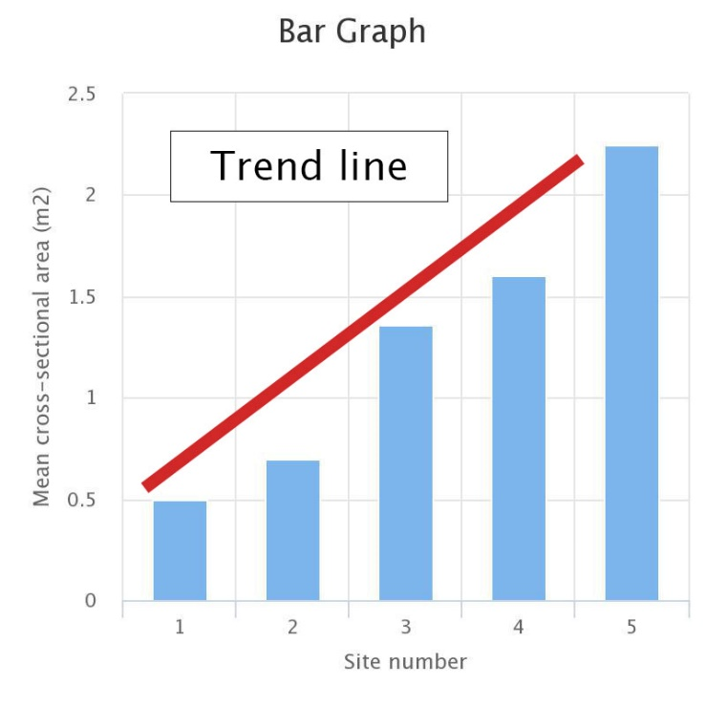
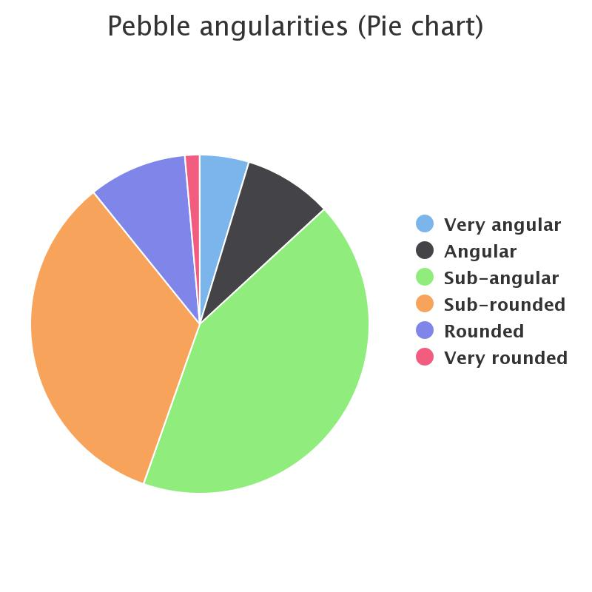
What are ‘trends’ and ‘patterns’?
Trends are changes that take place usually over time or distance
The mean cross-sectional area is increasing from Site 1 to Site 5
Patterns suggest a degree of regularity in the distribution of data. The term is most often applied to mapped data but can also apply to graphs such as pie charts
The pie chart shows that the vast majority of pebbles (over 75%) are sub-angular or sub-rounded

Slide 5
Identify using GCSE
G C – general comment, describing the overall patterns of trends illustrated by a graph or diagram
S – refer to specific details to support your comments (e.g. facts and figures taken from a graph)
E – identify any exceptions or anomalies, e.g. a value that doesn’t fit the trend

Slide 6
Analysis and interpretation
This involves attempting to explain or give reasons for the results that you have obtained
You should use the word ‘because’
Refer to appropriate geographical processes and concepts, or models such as the Bradshaw Model when studying rivers
Make use of your wider geographical knowledge
Consider possible reasons for any exceptions

Slide 7
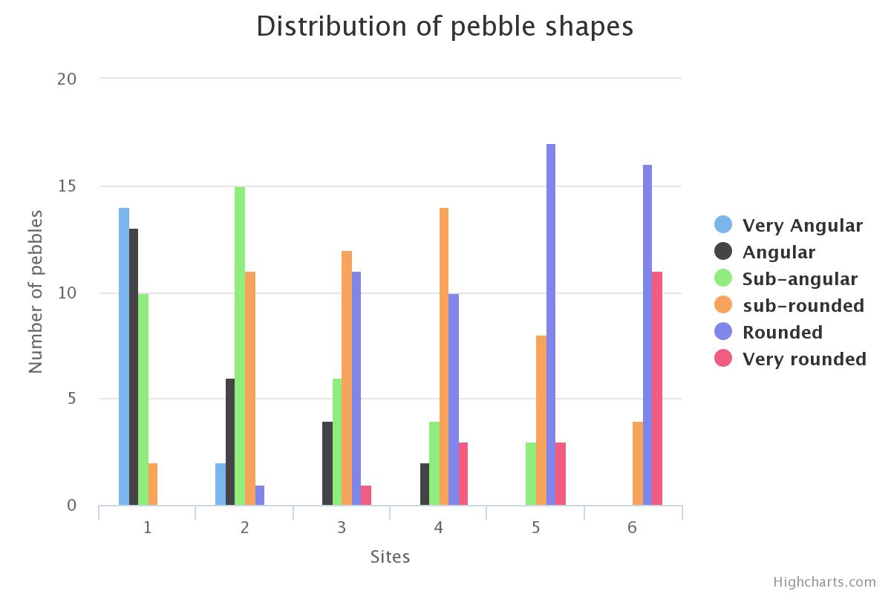
Analysing data: coasts
Attempt to identify trends and patterns in describing this graph – remember GCSE!

Slide 8
Analysing data: coasts
Here are some of the points you might have mentioned. Notice reference to trends and also the use of supporting evidence:
G C - The histogram shows that pebbles are becoming less angular (more rounded) with distance along the beach from Site 1 to Site 6. There is a smaller range of pebble angularities with distance along the beach.
S - At Site 1, 65% of pebbles were either very angular or angular. This had fallen to 23% at Site 2 and to 0% at Sites 5 and 6. In contrast, the proportion of rounded and very rounded pebbles increased along the beach from 0% at Site 1, 34% at Site 3 and 88% at Site 5
E – At Site 4, there was a slight fall in rounded pebbles – given the values at Sites 3 and 5, this category would be expected to be slightly higher .
Now have a go at analysis and interpretation!

Slide 9
Analysing data: coasts
Here is some analysis and interpretation:
“The overall trend of decreasing angularity is consistent with the direction of longshore drift (from Site 1 to Site 5.
As pebbles are transported along the coast, the processes of attrition and abrasion smooth and round the pebbles. Cliff erosion probably accounts for most of the angular pebbles at Site 1. The slightly lower value of rounded pebbles at Site 4 may be due to human error in measuring.”

Slide 10
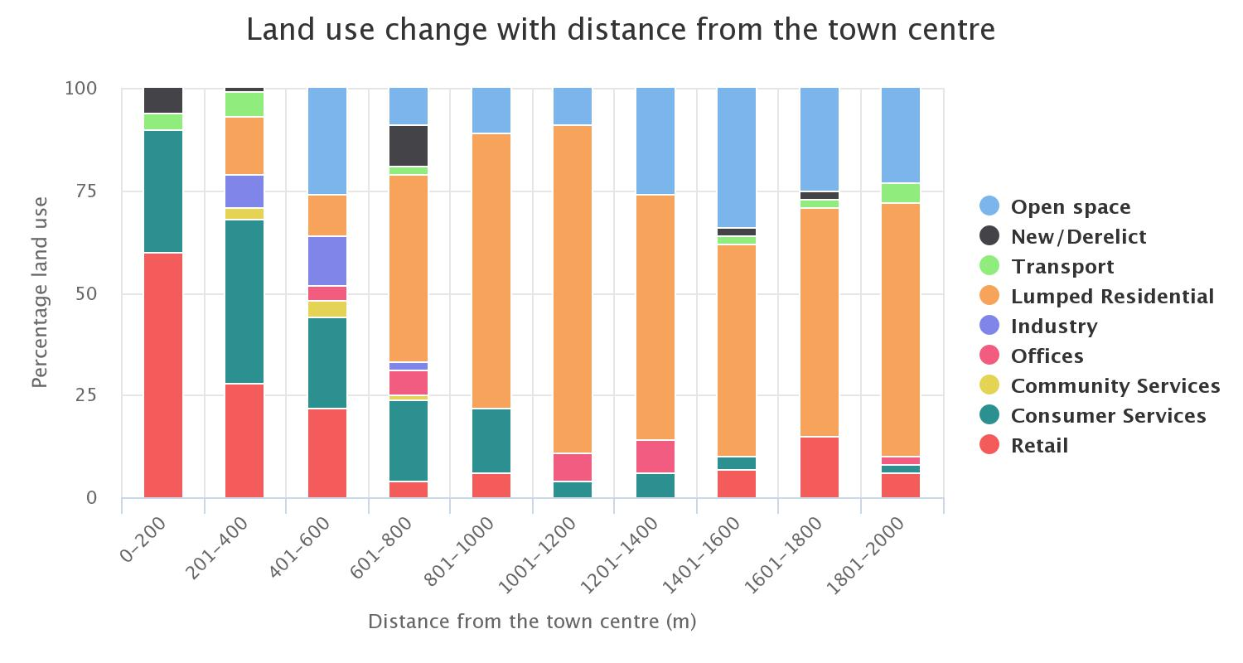
Analysing data: urban
Attempt to identify trends and patterns in describing this graph – remember GCSE!

Slide 11

Analysing data: urban
Here are some of the points you might have mentioned. Notice reference to trends and also the use of supporting evidence:
G C - The divided bar graph shows that there is a significant change in land use with distance from the town centre.
S – Close to the town centre there is a dominance of retailing (58%) and consumer services (35%). The percentage of these two land uses decreases significantly to about 14% at 8001-1000 metres from the town centre. Residential land use increases towards the edge of the town to reach a maximum of about 80% at 1001-1200 metres from the town centre.
E – There is no retailing at 1001 – 1200 and 1201 – 1400 yet it occurs close to the town centre and towards the outskirts

Slide 12
Analysing data: urban
Here is some analysis and interpretation:
“The dominance of retailing and consumer services close to the town centre reflects the historic development of the town around its central most accessible point.
Land here is in short supply and is expensive. The increase in residential land use towards the edge of the town is probably due to the availability of relatively cheap land for building. Retailing at the edge of the town probably takes the form of retail parks, benefiting from good transport links.”

Slide 13
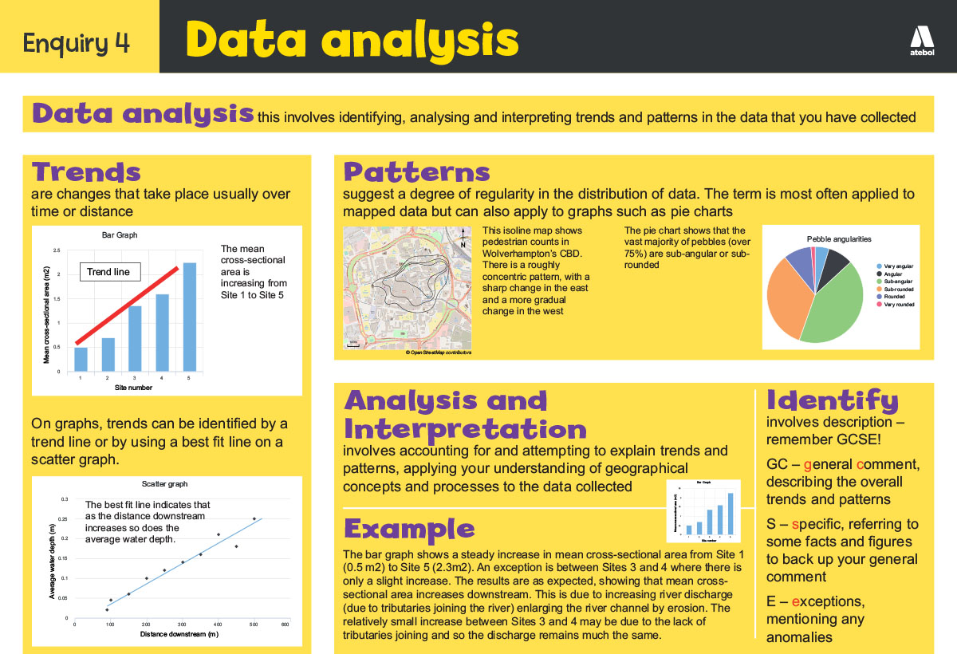
Now take a look!

Slide 14
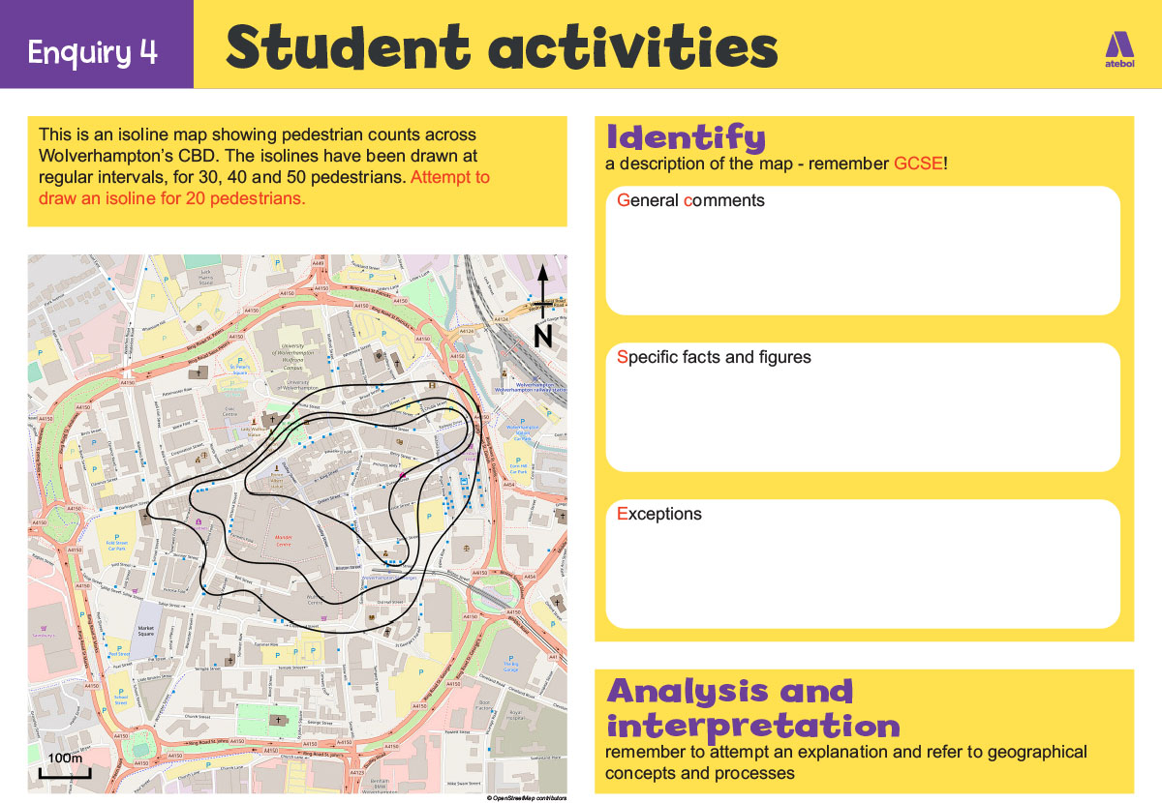
Now have a go!

Slide 15
Nominated criteria
Table A: Methodologies
2018: Geographical flows
2019: Qualitative surveys
2020: Use of transects
Table B: Conceptual framework
2018: Cycles and flows
2019: Place
2020: Sphere of Influence

